Slide 1
The Fifteen Puzzle
Team 13
Leader – alexander nguyen

Slide 3
WELCOME

Slide 4
WELCOME

Slide 5
WELCOME
WELCOME

Slide 6
WELCOME

Slide 7
WELCOME

Slide 8
WELCOME
WELCOME

Slide 9
WELCOME

Slide 10
WELCOME

Slide 11
WELCOME

Slide 12


Slide 13
Sliding Puzzle Game
LOADING….

Slide 14
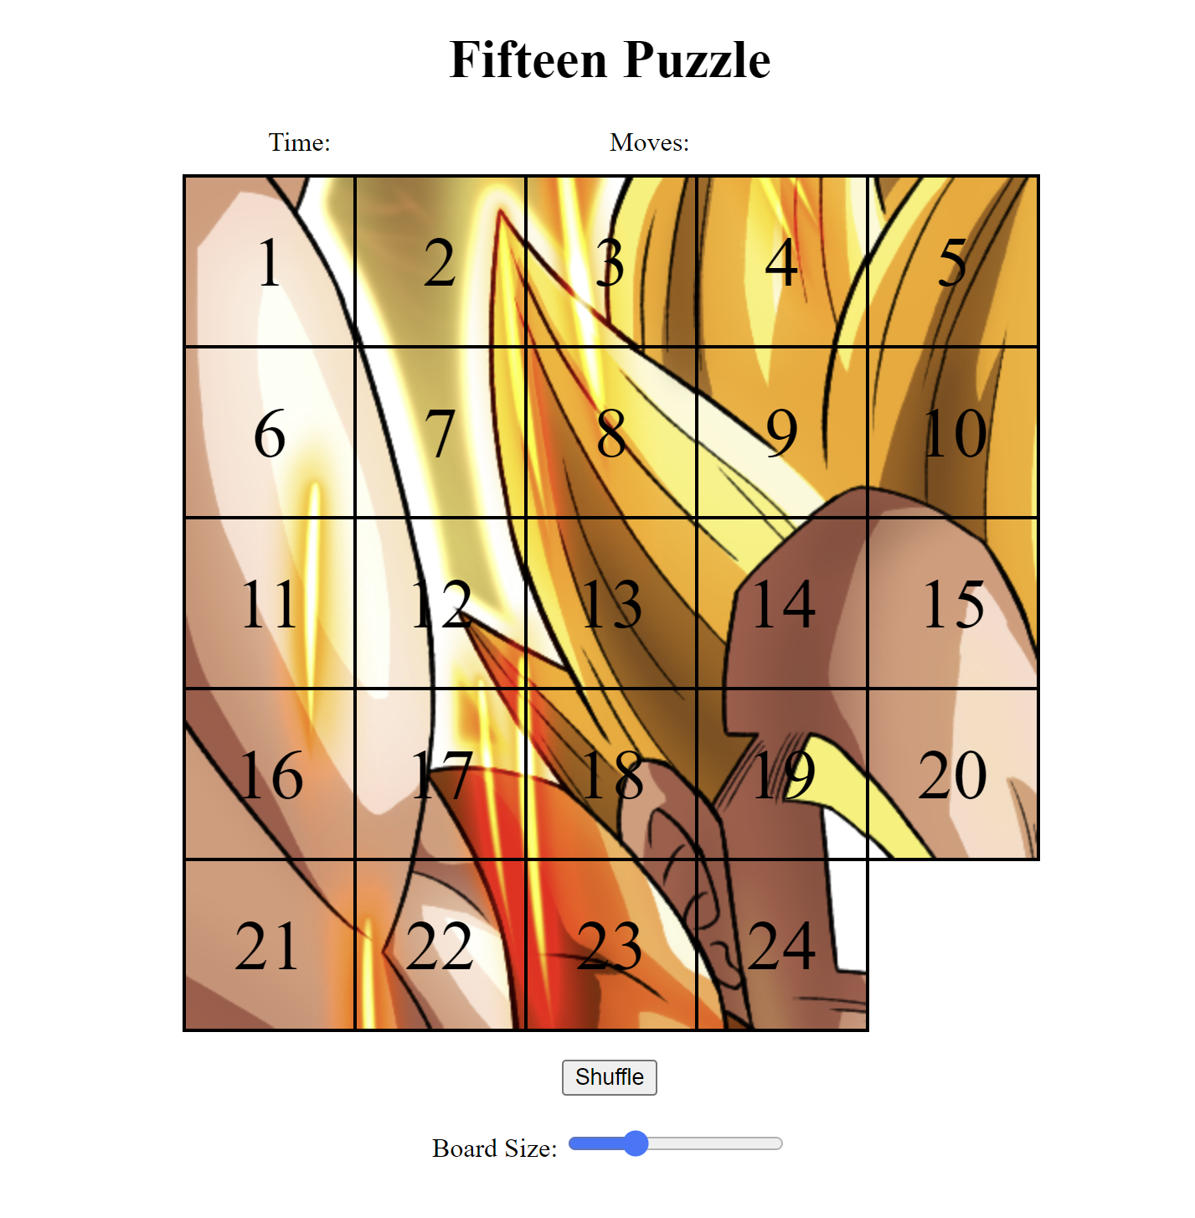
OVERVIEW
What is the Sliding Puzzle?
A puzzle on an n x n grid containing n-1 pieces. You must utilize the empty space to slide the pieces on the board. The puzzle’s solved when all the pieces are in their proper, numbered order (from 1 to n*n-1), and the empty space is in the bottom right of the grid.

Slide 15


Key Features
Sign-up/ Login:
The user is asked to sign-up and then login to play the game.
Leaderboard: Based on the users’ scores, they will be ranked and displayed in descending order.
Resizing: The game’s most known for its 4x4 variation, but you can play from 3x3 to 10x10.
Forms Processing: The use of forms was used to store the registration/login information and for the validity of user answers.
Timer: A fully functional timer to see how long it takes you to solve the puzzle.

Slide 16
Key Features
Shuffle: With one click,
your puzzle is randomly shuffled in a solvable way.
Leaderboard: Based on the users’ scores, they will be ranked and displayed in descending order.
Resizing: The game’s most known for its 4x4 variation, but you can play from 3x3 to 10x10.
Forms Processing: The use of forms was used to store the registration/login information and for the validity of user answers.
Timer: A fully functional timer to see how long it takes you to solve the puzzle.

Slide 17
Key Features
Shuffle: With one click, your puzzle is randomly shuffled in a solvable way.
Leaderboard: Based on the users’ scores, they will be ranked and displayed in descending order.
Resizing: The game’s most known for its 4x4 variation, but you can play from 3x3 to 10x10.
Forms Processing: The use of forms was used to store the registration/login information and for the validity of user answers.
Timer: A fully functional timer to see how long it takes you to solve the puzzle.

Slide 18
Key Features
Shuffle: With one click, your puzzle is randomly shuffled in a solvable way.
Backgrounds: You get to view a randomly selected background. The bigger the grid, the more is revealed.
Resizing: The game’s most known for its 4x4 variation, but you can play from 3x3 to 10x10.
Music/Celebration: Enjoy the music while you’re playing and savor a fun celebration every time you solve it.
Timer: A fully functional timer to see how long it takes you to solve the puzzle.

Slide 19
Key Features
Shuffle: With one click, your puzzle is randomly shuffled in a solvable way.
Backgrounds: You get to view a randomly selected background. The bigger the grid, the more is revealed.
Resizing: The game’s most known for its 4x4 variation, but you can play from 3x3 to 10x10.
Music/Celebration: Enjoy the music while you’re playing and savor a fun celebration every time you solve it.
Timer: A fully functioning timer to see how long it takes you to solve the puzzle.

Slide 20
Key Features
Shuffle: With one click, your puzzle is randomly shuffled in a solvable way.
Backgrounds: You get to view a randomly select background. The bigger the grid, the more is revealed.
Resizing: The game’s most known for its 4x4 variation, but you can play from 3x3 to 10x10.
Music/Celebration: Enjoy the music while you’re playing and savor a fun celebration every time you solve it.
Timer: A fully functioning timer to see how long it takes you to solve the puzzle.

Slide 21
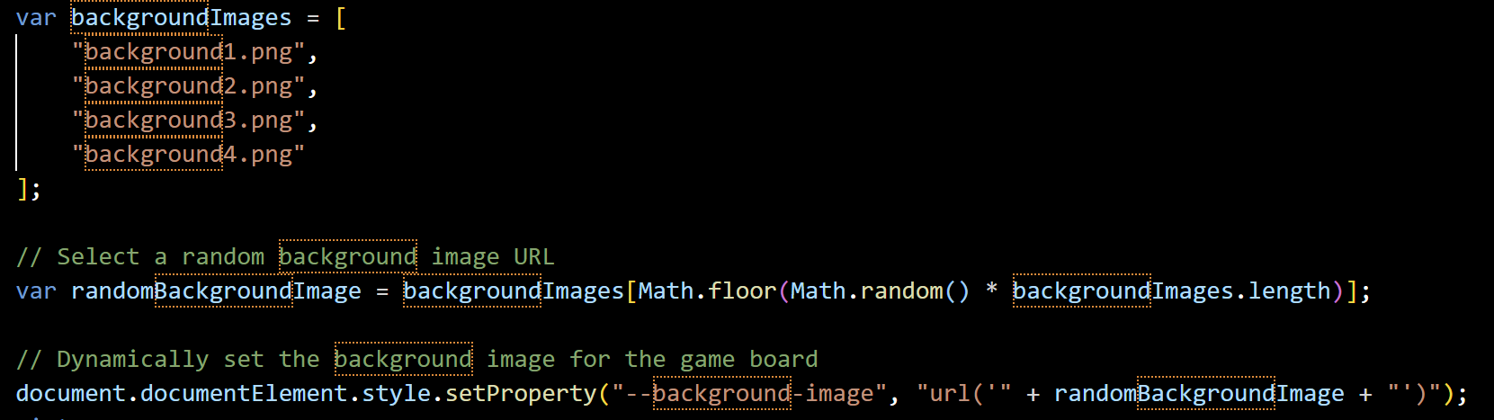
CODE SNIPPETS – BACKGROUND

Slide 22
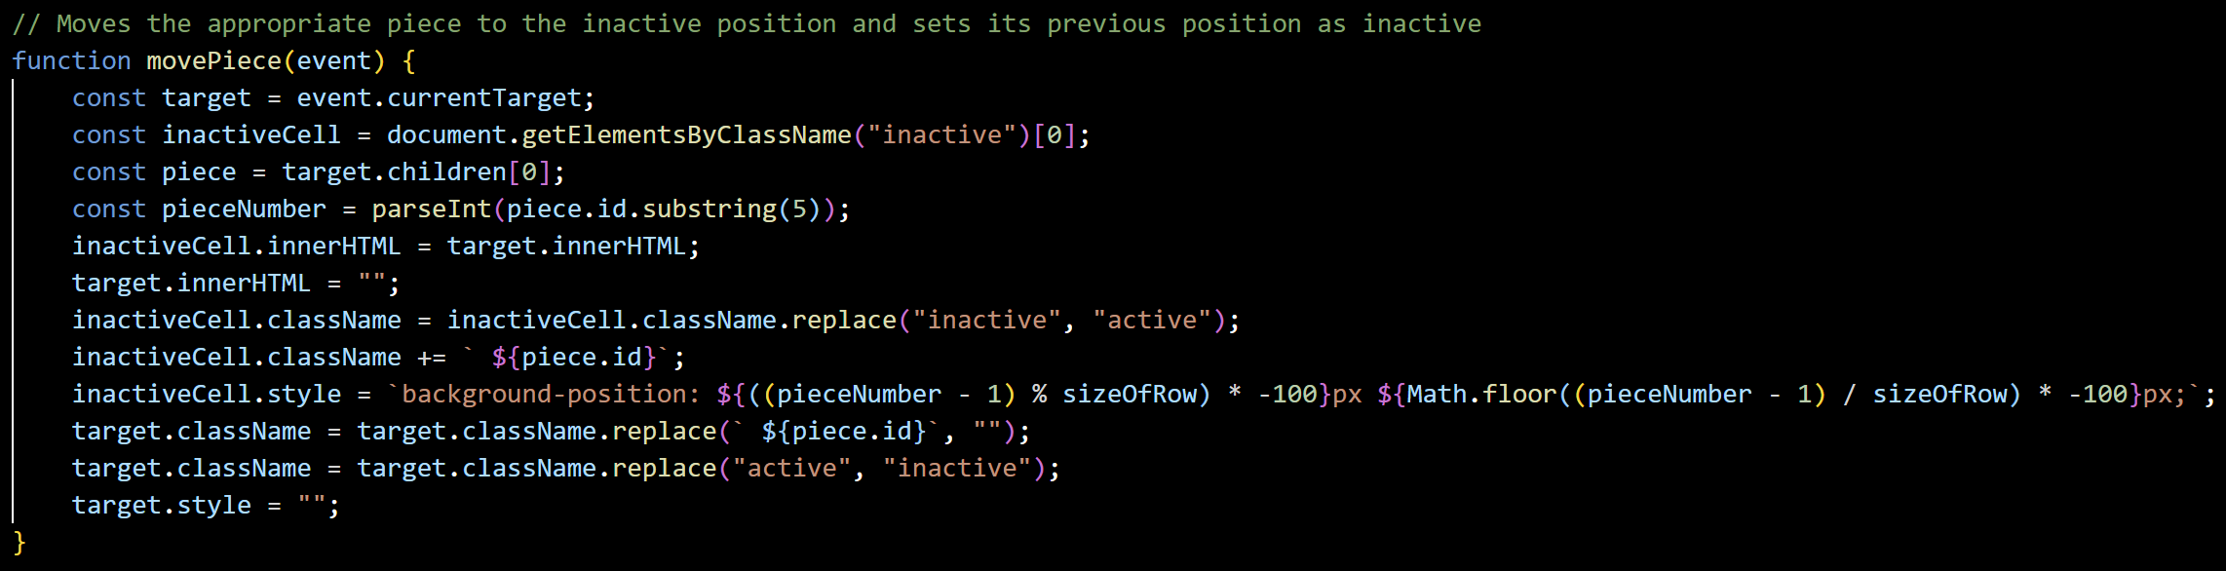
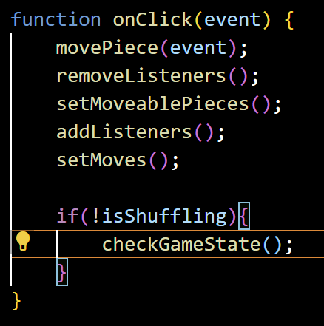
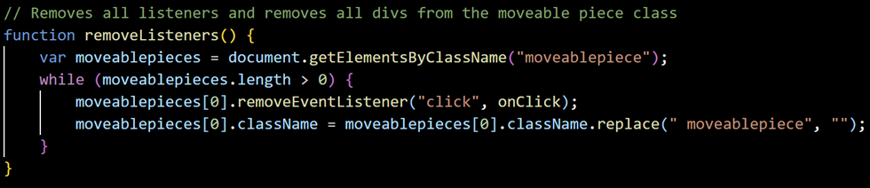
CODE SNIPPETS – MOVING A PIECE

Slide 23
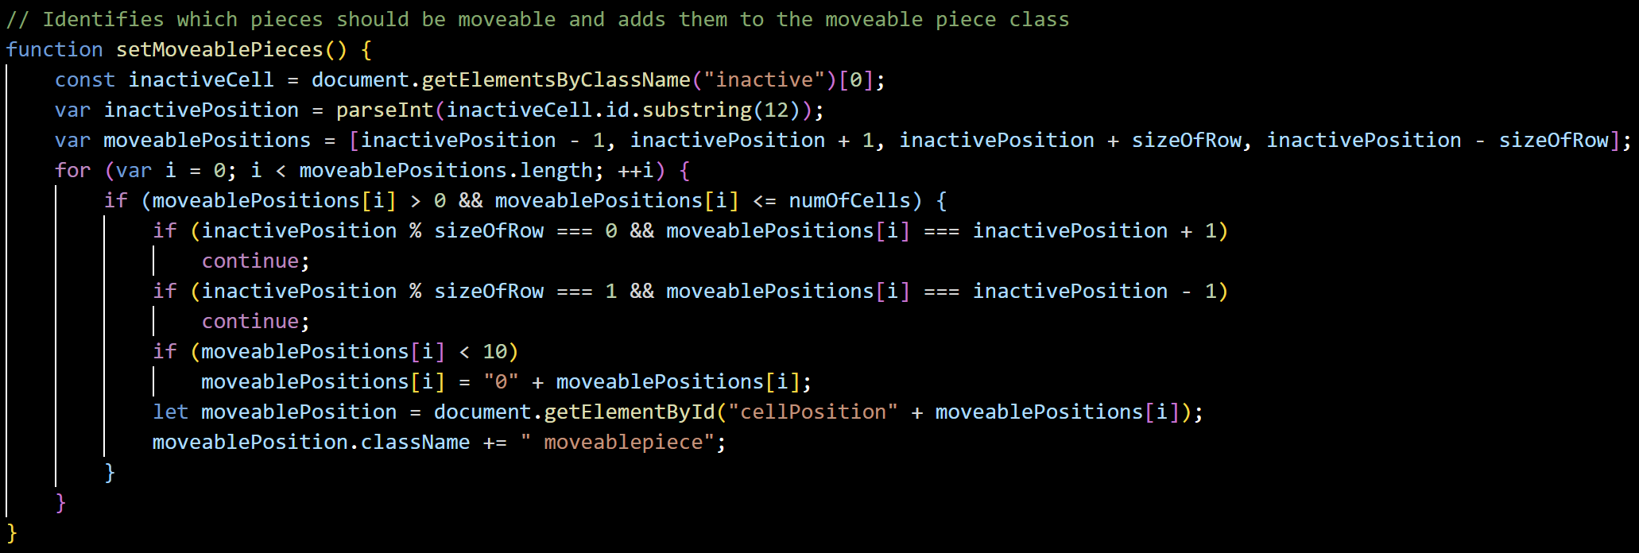
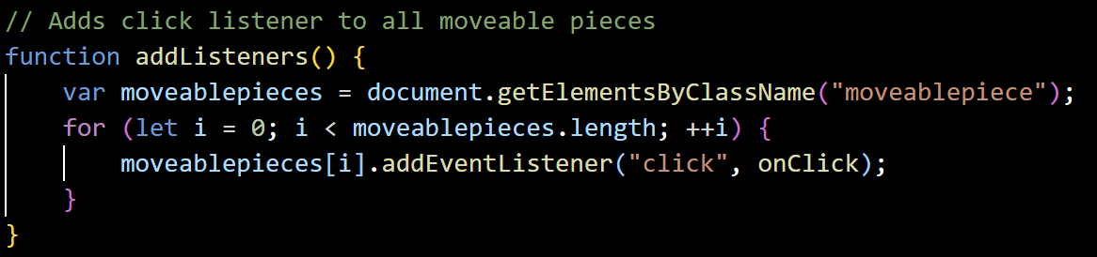
CODE SNIPPETS – MOVING A PIECE, cont’d

Slide 24
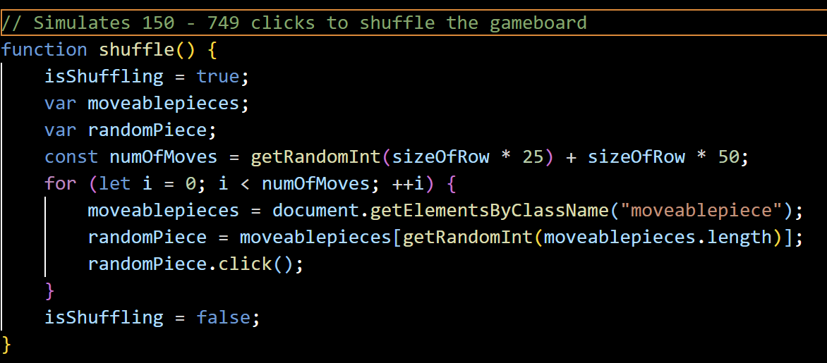
CODE SNIPPETS - SHUFFLE

Slide 25
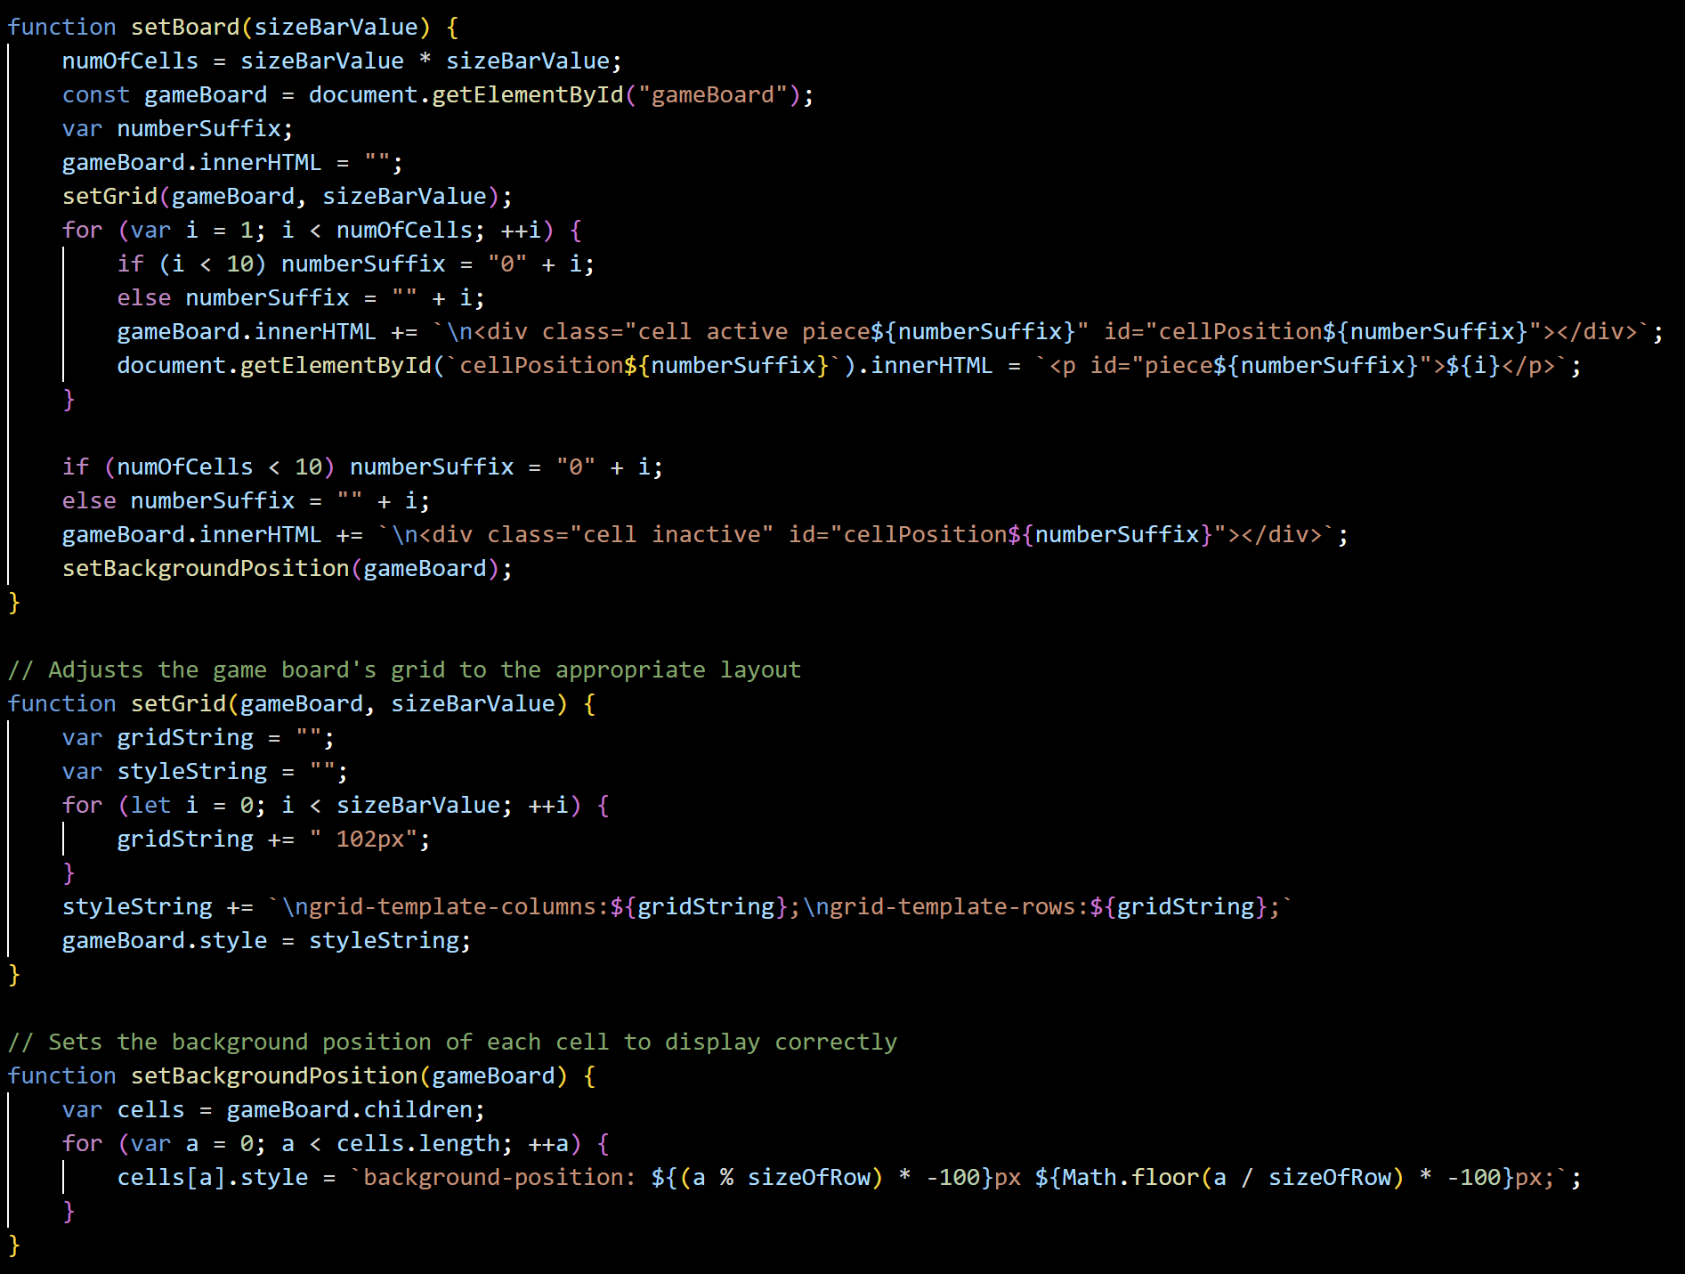
CODE SNIPPETS – RESIZING BOARD

Slide 26
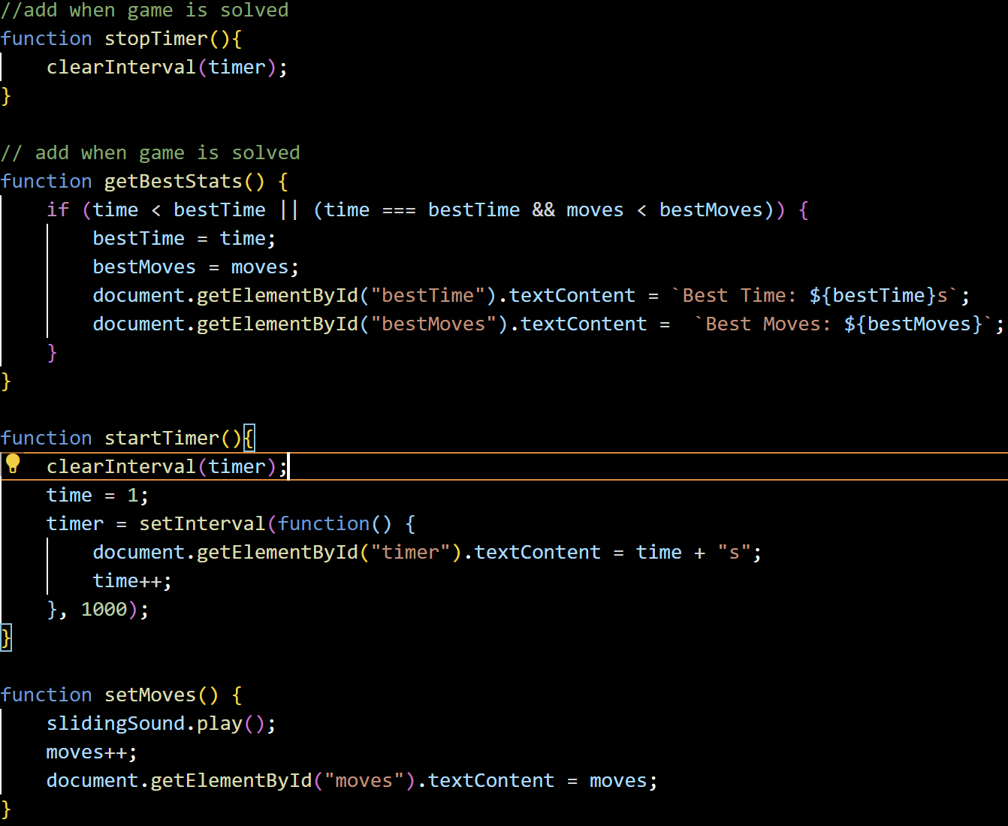
CODE SNIPPETS - STATS

Slide 27
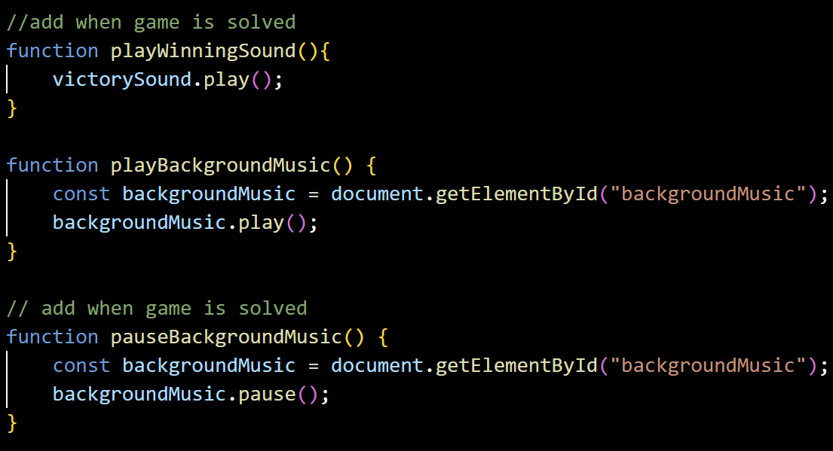
CODE SNIPPETS - AUDIO

Slide 28
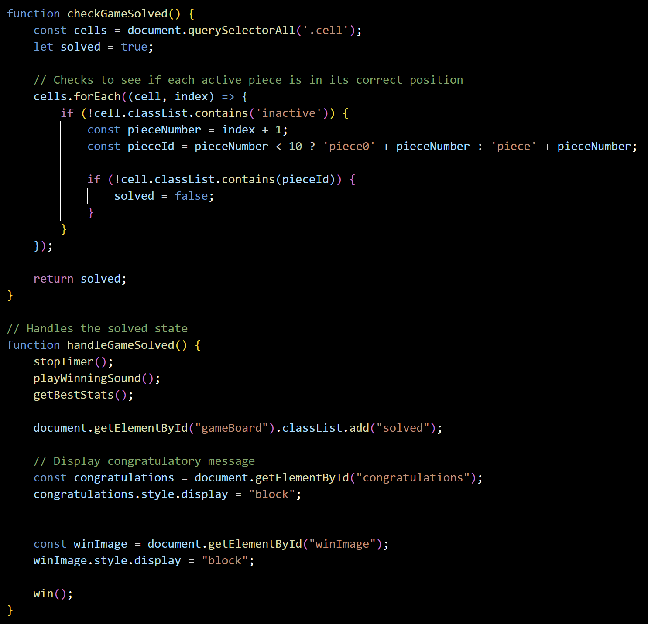
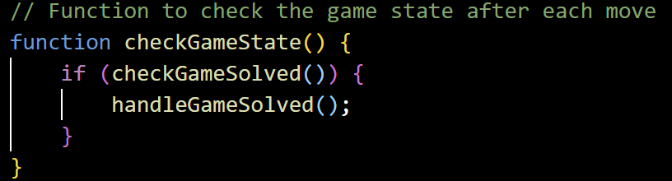
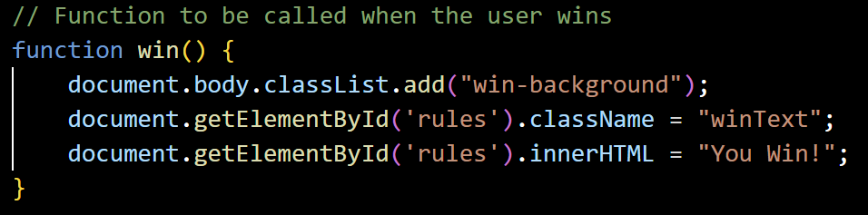
CODE SNIPPETS - WINNING

Slide 29
DEMO
Project Link:
https://codd.cs.gsu.edu/~anguyen127/WP/PW/3/fifteen.html

Slide 30

Demo Run

Slide 31
Future Applications

Slide 32
Future Applications
School Game:
Puzzles are often used to give young children a fun break while also keeping their minds engaged. Using a sliding puzzle would be perfect for this kind of thing. It mentally engaging but also different enough from normal school activities for students to return rejuvenated.

Slide 33
Future Applications
School Game:
Puzzles are often used to give young children a fun break while also keeping their minds engaged. Using a sliding puzzle would be perfect for this kind of thing. It mentally engaging but also different enough from normal school activities for students to return rejuvenated.
Competition:
Whether for friendly bragging rights or for serious gains, this game could be a great form of competition. It even offers variations on the type of competition. For example, the winner could be determined by time taken, number of moves made, or a combination of the two.

Slide 34
Future Applications
School Game:
Puzzles are often used to give young children a fun break while also keeping their minds engaged. Using a sliding puzzle would be perfect for this kind of thing. It mentally engaging but also different enough from normal school activities for students to return rejuvenated.
Competition:
Whether for friendly bragging rights or for serious gains, this game could be a great form of competition. It even offers variations on the type of competition. For example, the winner could be determined by time taken, number of moves made, or a combination of the two.
Leisure:
You may be a puzzle-loving teen, a parent winding down from a busy day, or a retiree looking to pass the time. No matter your age or background, this versatile game can be a great source of healthy entertainment for you.

Slide 35
Summary

Slide 36
Summary
Our Fifteen Puzzle is a web-based puzzle game utilizing HTML, Javascript, and CSS. Its features include random backgrounds, a resizable board, a timer, a move counter, and music/celebration. Just a few of its many applications include being used a school game for children, being played competitively, or being played for leisure.

Slide 37
THE DEVOPS METHODOLOGY
Effective organizational tool
Allows for a common space for team to communicate and hold each other accountable
Promotes efficient project planning
Process is streamlined for efficient delivery
Keeps the team up-to-date on the progress of the project

Slide 38


